Slide 1

Data Visualization & Analysis
Transportation of goods
Chandan Acharya
Devendra Hupri
Rakesh Lagare
Nagesh TR

Slide 2


Environmental Impact
Transportation
Fuel Consumed
CO2 Released

Slide 3
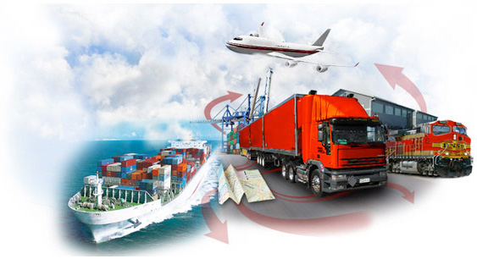
Energy consumption

Slide 4
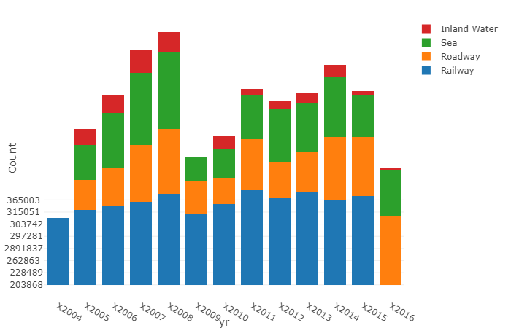
Preferred Ways of goods transportation in Germany

Slide 5
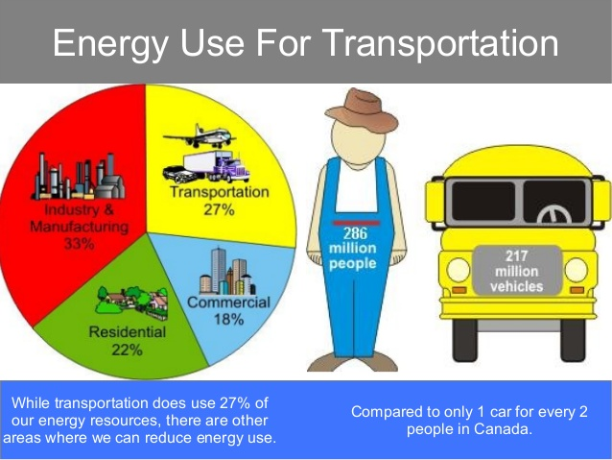


Slide 6
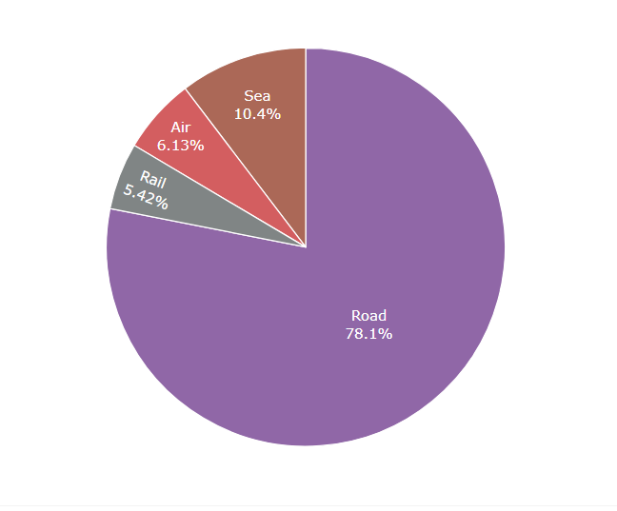
Fuel Consumed per transportation mode

Slide 7
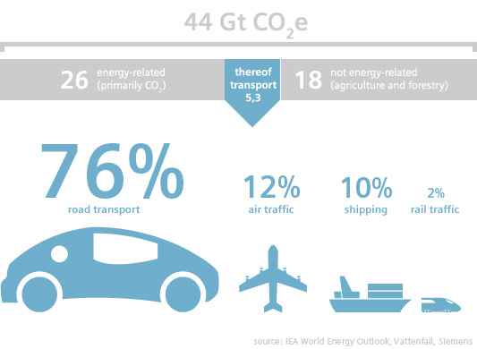
Co2 emission by transport mode

Slide 8
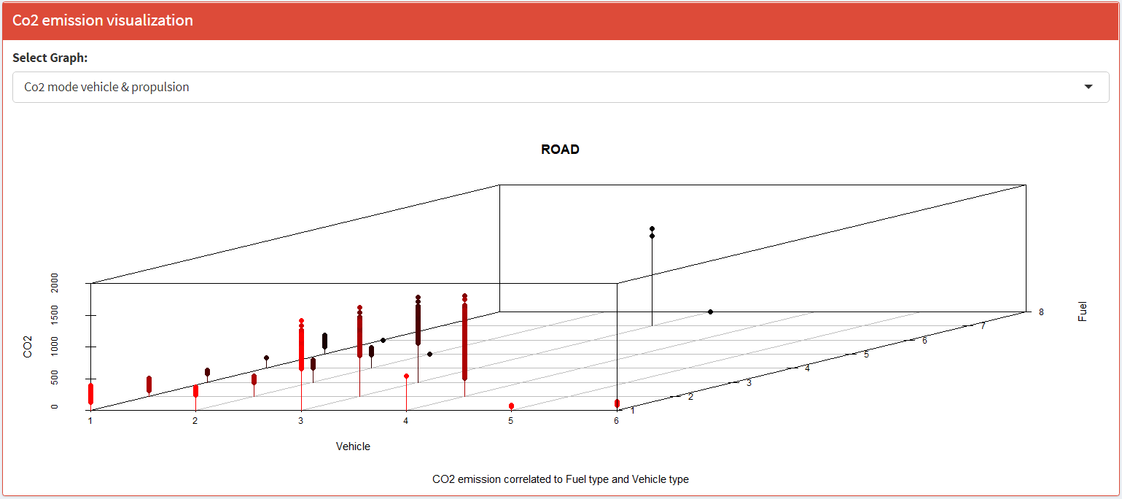
Co2 emission by vehicle type and propulsion

Slide 9
